Slide 1

System constant Coding GUIDLINE…

Slide 2
Agenda
6.7.2 Fixed and stable System Constants:
1 Definition of Fixed system constant
2 Definition of Stable system constant
6.7.2.1 Generation of #defines in .h files
1 Case 1
2 Case 2
3 Case 3
6.7.3 Adjustable system constant
1 Specification of logical types in the eASEE-SDOM normalization editor
2 Value range extension
3 Importing an adjustable system constant 4 System constant (#IF) condition in C-code
2
RBVH/EJV | 2018-12-09
© Robert Bosch Engineering and Business Solutions Vietnam Company Limited 2018. All rights reserved, also regarding any disposal, exploitation, reproduction, editing, distribution, as well as in the event of applications for industrial property rights.

Slide 3
6.7.2 Definition of Fixed system constant
Coding Guideline
Defined by a convention “FIXED system constants are unchangeable during lifetime.”
Used for
Pre-compiler options, but not for conditioned compilation
display states of variables, e.g. FALSE, TRUE. (centrally defined)
limits of types, e.g. MAXSINT16. (centrally defined)
scientific constants, e.g. PI (centrally defined)
generic #defines, that may not be changed during lifetime. Used within a package as processing information.
Definition and owner’s scope:
More than 1 BC: central elements by clearing request in the Architecture Clearing Portal
Only 1 BC: inside this BC
References to system constants of category FIXED
3
RBVH/EJV | 2018-12-09
© Robert Bosch Engineering and Business Solutions Vietnam Company Limited 2018. All rights reserved, also regarding any disposal, exploitation, reproduction, editing, distribution, as well as in the event of applications for industrial property rights.

Slide 4
6.7.2 Definition of Stable system constant
Coding Guideline
Defined by a convention “STABLE system constants are fixed within a version. This means a limitation value can be changed from one version to another. But this convention does not have an effect on any aspect of configuration.”
Used for
physical conversion factors, e.g. milliseconds to microseconds NORM_MS2US
time basis values, e.g. TIME_US_400NS_RES
quantization values, e.g. LAMBDARESREV_SY, RES_FACT_256)
limits values and thresholds, e.g. EPM_N_MAX
generated system constants
Definition and owner’s scope:
More than 1 BC: central elements by clearing request in the Architecture Clearing Portal
Only 1 BC: inside this BC
References to system constants of category FIXED, ADJUSTABLE, STABLE
4
RBVH/EJV | 2018-12-09
© Robert Bosch Engineering and Business Solutions Vietnam Company Limited 2018. All rights reserved, also regarding any disposal, exploitation, reproduction, editing, distribution, as well as in the event of applications for industrial property rights.

Slide 5
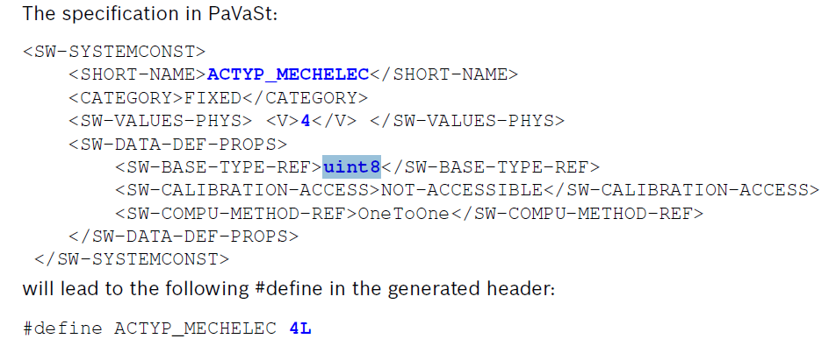
6.7.2.1 Generation of #defines in .h files
Coding Guideline
Case 1:
System constant value <= MAXSINT32
Based type:uint8, sint8, uint16, sint16, sint32
5
RBVH/EJV | 2018-12-09
© Robert Bosch Engineering and Business Solutions Vietnam Company Limited 2018. All rights reserved, also regarding any disposal, exploitation, reproduction, editing, distribution, as well as in the event of applications for industrial property rights.

Slide 6
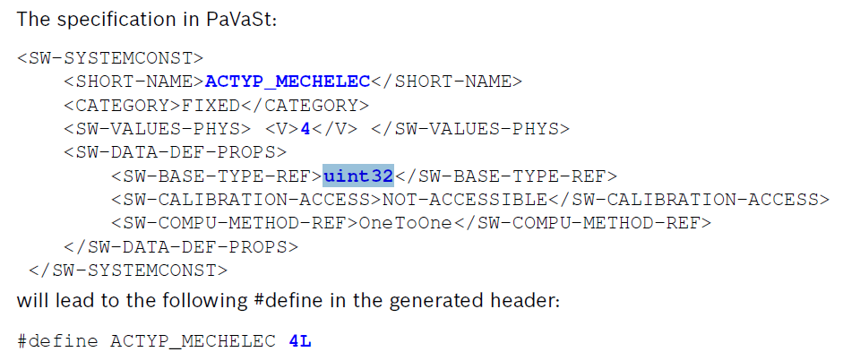
6.7.2.1 Generation of #defines in .h files
Coding Guideline
Case 2:
System constant value <= MAXSINT32
Base type: uint32
Therefore it is not possible in Bosch to specify a system constant with a small value in PaVaSt in such a way that an "U" suffix is generated in the #define.
6
RBVH/EJV | 2018-12-09
© Robert Bosch Engineering and Business Solutions Vietnam Company Limited 2018. All rights reserved, also regarding any disposal, exploitation, reproduction, editing, distribution, as well as in the event of applications for industrial property rights.

Slide 7
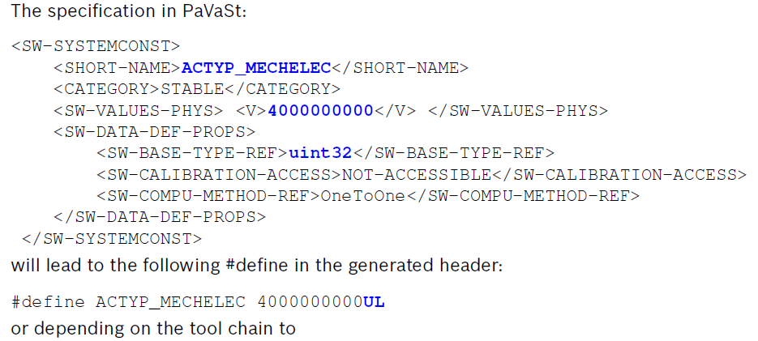
6.7.2.1 Generation of #defines in .h files
Coding Guideline
Case 3:
System constant value > MAXSINT32
Base type: uint32
C90 (32-bit environment): unsigned integer type – Bosch sw using
C99: long long (signed) int type
Difference in behavior: The sizeof operator returns the size 4 or 8..
7
RBVH/EJV | 2018-12-09
© Robert Bosch Engineering and Business Solutions Vietnam Company Limited 2018. All rights reserved, also regarding any disposal, exploitation, reproduction, editing, distribution, as well as in the event of applications for industrial property rights.

Slide 8
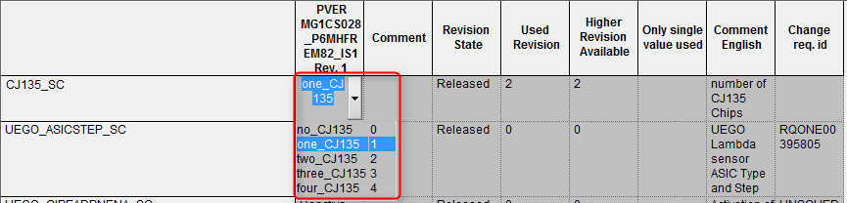


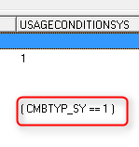
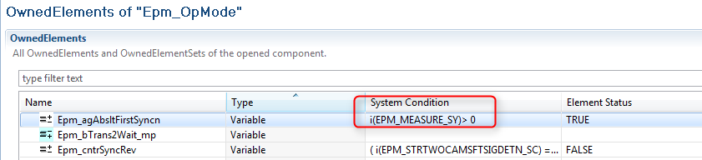
6.7.3 Adjustable System Constants
Coding Guideline
concept
An adjustable system constant represents a switchable feature. Within a particular project the adjustable system constants have to be set to one of the specified values.
Usage Adjustable system constants are used for
pre compiler options in C-Code,
for conditional compilation in C-code,
for conditional interfaces (e.g. resulting from conditional compilation) (<SW-VARIABLE-REF-SYSCOND> etc.)
for definition of element properties like array size etc.
for the component selection mechanism via setting of conditions in eASEE-SDOM,
for documentation of the verification and validation condition of the FC in eASEE-SDOM,
for conditional documentation (attribute SYSCOND).
8
RBVH/EJV3 | 2018-12-09
© Robert Bosch Engineering and Business Solutions Vietnam Company Limited 2018. All rights reserved, also regarding any disposal, exploitation, reproduction, editing, distribution, as well as in the event of applications for industrial property rights.

Slide 9
6.7.3 Adjustable System Constants
Coding Guideline
Usage
Adjustable system constants are not used for
within computation methods ( <SW-COMPUMETHOD>) (exceptions are described in See Chapter A.6 "Computation methods with referenced system constant" p. 197 ),
for specification of different implementations of the same element (see <SW-DATA-DEF-PROPS-SYSCONDS>)
9
RBVH/EJV3 | 2018-12-09
© Robert Bosch Engineering and Business Solutions Vietnam Company Limited 2018. All rights reserved, also regarding any disposal, exploitation, reproduction, editing, distribution, as well as in the event of applications for industrial property rights.

Slide 10
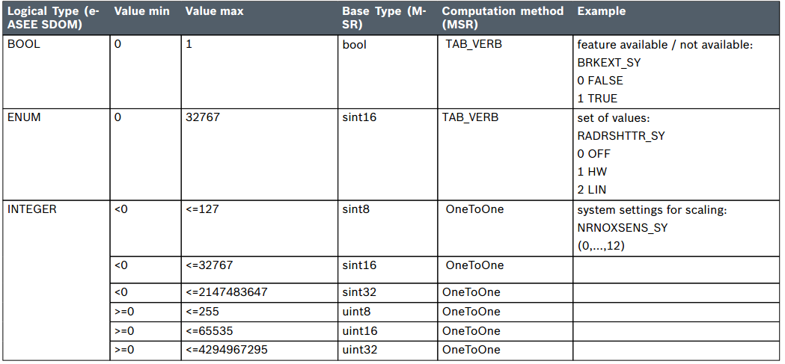
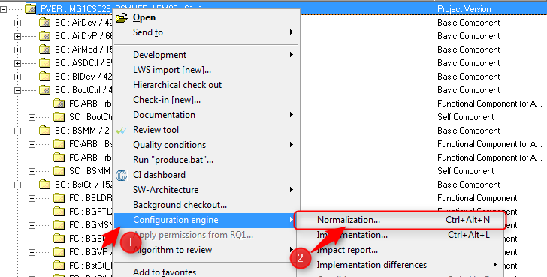
6.7.3.1 Specification of logical types in the eASEE-SDOM normalization editor
Coding Guideline
Adjustable system constants are specified via the eASEE-SDOM tool normalization editor
Mapping of eASEE SDOM logical types to MSR base types
10
RBVH/EJV3 | 2018-12-09
© Robert Bosch Engineering and Business Solutions Vietnam Company Limited 2018. All rights reserved, also regarding any disposal, exploitation, reproduction, editing, distribution, as well as in the event of applications for industrial property rights.

Slide 11
6.7.3.1 Specification of logical types in the eASEE-SDOM normalization editor
Coding Guideline
The logical type FLOAT is not allowed for adjustable system constants. Because float constants are not allowed inside preprocessor statements.
11
RBVH/EJV3 | 2018-12-09
© Robert Bosch Engineering and Business Solutions Vietnam Company Limited 2018. All rights reserved, also regarding any disposal, exploitation, reproduction, editing, distribution, as well as in the event of applications for industrial property rights.

Slide 12
6.7.3.2 Value range extension
Coding Guideline
The following rules have to be followed to assure that extensions of the value range are save: 1. When importing a system constant the limits considered at the time when the system constant was introduced to the function component shall be given. It's for documenting the tested condition for the C-code. 2. When expanding the value range it shall only be possible to increase the value range. (Only a larger number can be added). 3. System constant conditions in C-Code shall reflect exactly the implied restrictions in functionality of the function component: #if (RADRSHTTR_SY > 0) && (RADRSHTTR_SY <= 2) /* Code is designed only for STASUPRT, NOSTASUPRT */ #if (RADRSHTTR_SY != 0) /* Code is designed also for future features */ /* except direct start is disabled */ 4. The software configuration tool chain supports the developers to identify new revisions of the system constants. When a change is detected the data constraint shall be updated.
If a function component is incorporated into a programstand which already requires a newer feature (value) which is outside the limits given in the function component, then the tools will give warnings.
12
RBVH/EJV3 | 2018-12-09
© Robert Bosch Engineering and Business Solutions Vietnam Company Limited 2018. All rights reserved, also regarding any disposal, exploitation, reproduction, editing, distribution, as well as in the event of applications for industrial property rights.

Slide 13
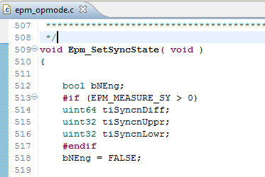
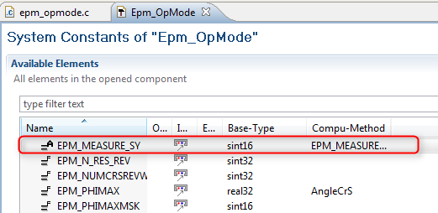
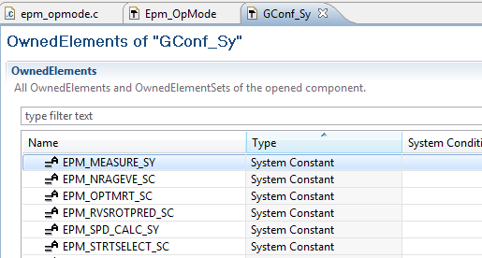
6.7.3.3 Importing an adjustable system constant
Coding Guideline
If a system constant is used in a C-file or H-file, it must be referenced in the corresponding PaVaSt -file of the FC
The declaration given in the normalization editor is configured by the project engineers prior to compilation. A central file gconf_sy_pavast.-xml is generated by the tool chain dependent on the project configuration
A system constant which is used but not created does not generate a compiler error message! The program is compiled as if the system constant was set to 0
→consistency checks by the architecture tools and by build tools
instruction is added on top of the c-file or on top of the h-file because of the high criticality #ifndef GDI_SY #error '>>>> GDI_SY undefined!' #endif Or #ifndef GDI_SY #error >>>> 'GDI_SY' undefined! #endif
13
RBVH/EJV3 | 2018-12-09
© Robert Bosch Engineering and Business Solutions Vietnam Company Limited 2018. All rights reserved, also regarding any disposal, exploitation, reproduction, editing, distribution, as well as in the event of applications for industrial property rights.

Slide 14
6.7.3.4 System constant (#IF) condition in C-code
Coding Guideline
it is possible to use adjustable system constants In C-code for pre compiler conditions because At MEDC17 an adjustable system constant is finally provided as a #define in a central header file The following rules shall be considered:
At DGS MEDC17 only adjustable system constants are used at the left side of the conditions.
The #IF line evaluates to a constant integer expression (which may not include sizeof, casts, or enum constants).
All other operators which are allowed in C-expressions are allowed on the right side of the #IF line.
Adjustable system constants must not be defined as float constants. (Compiler error, if used inside #IF condition).
Although the pre processor requires only a constant integer expression at DGS MEDC17 the operands of boolean operators and the result of a #IF condition shall be boolean.
14
RBVH/EJV31 | 2018-12-09
© Robert Bosch Engineering and Business Solutions Vietnam Company Limited 2018. All rights reserved, also regarding any disposal, exploitation, reproduction, editing, distribution, as well as in the event of applications for industrial property rights.

Slide 15
6.7.3.4 System constant (#IF) condition in C-code
Coding Guideline
The following two conditions are not allowed in DGS #if (RADRSHTTR_SY) -->ENUM #if (NRNOXSENS_SY) ------->INTEGER Rules for using parantheses in system constant conditions in C-Code
The condition shall be given in brackets.
It is allowed to use comparison operators and negative constants without additional parantheses. But in general parantheses are required for a negative constant. Allowed: #if (NRNOXSENS_SY == -1) /* allowed */ #if (NRNOXSENS_SY > -1) /* allowed */ #if (NRNOXSENS_SY != -1) /* allowed */
Wrong | Correct
#if NRNOXSENS_SY == 4 #if NRNOXSENS_SY || RADRSHTTR_SY == 2 | #if (NRNOXSENS_SY == 4) #if ((NRNOXSENS_SY == 8) || (RADRSHTTR_SY == 2))
15
RBVH/EJV31 | 2018-12-09
© Robert Bosch Engineering and Business Solutions Vietnam Company Limited 2018. All rights reserved, also regarding any disposal, exploitation, reproduction, editing, distribution, as well as in the event of applications for industrial property rights.

Slide 16
6.7.3.4 System constant (#IF) condition in C-code
Coding Guideline
Style guide rule in system constant conditions in C-Code:
No extra fixed system constants shall be requested for system conditions, the values shall be given with numbers. See also See 6.7.3.9 p. 89 correct: #if (RADRSHTTR_SY == 2) /* conditions can be given identically */ /* in C-code, PaVaSt, eASEE, etc. only */ /* with numbers
16
RBVH/EJV31 | 2018-12-09
© Robert Bosch Engineering and Business Solutions Vietnam Company Limited 2018. All rights reserved, also regarding any disposal, exploitation, reproduction, editing, distribution, as well as in the event of applications for industrial property rights.

Slide 17

Thank you
THANK YOU

